Slide 1
Variables and Datatypes

Slide 2
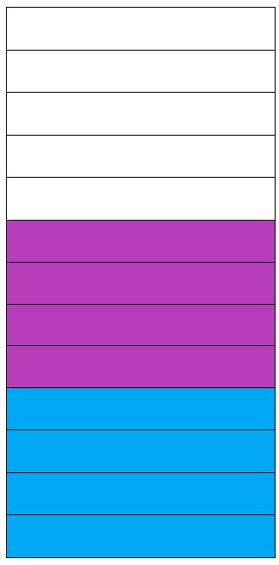
Variables
Variables:
A Variable is a container which holds the value while the program is being executed.
Variable is a name of Memory Location.
There are three types of Variables they are: Local, Instance and Static.
Unallocated Memory
expectedSalary = 180000;
Age = 22;

Slide 3
Variable
Syntax:
Declaring a variable:
Datatype variable name;
Assigning value to a variable:
Datatype variable name=value;
Getting value from a variable:
System.out.println(variable);
Example:
Declaring a variable:
byte age;
Assigning value to a variable:
byte age = 21;
Getting value from a variable:
System.out.println(age);

Slide 4
Datatypes
Datatypes:
Datatypes specifies the different sizes and values that can stored in an variable.
Two types of datatypes:
Primitive datatype: The primitive datatype include Boolean, char, byte, short, int, long, float and double.
Non- primitive datatype: the non-primitive datatype include Classes, Interfaces and Arrays.

Slide 5
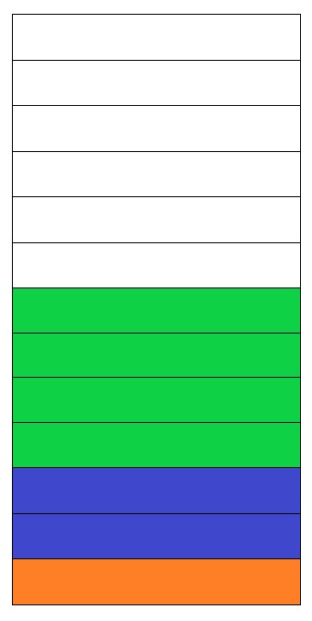
Datatypes
2012
2011
2010
Unallocated memory blocks
2009
2008
2007
2006
2005
Int employeesCount = 2147483648;
2004
2003
2002
short hoursPerYear = 8640;
2001
2000
Byte Age = 24;

Slide 6
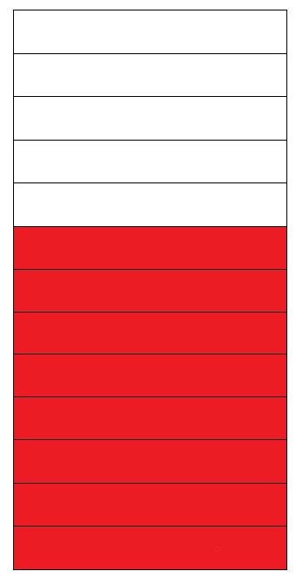
Datatypes
2025
2024
Unallocated Memory Block
2023
2022
2021
2020
2019
2018
2017
Double salary = 9223.372036854775808;
2016
2015
2014
2013

Slide 7
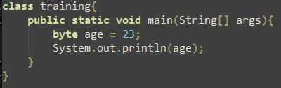
Byte Example
Code:
Output:

Slide 8
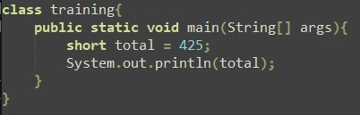
Short Example
Code:
Output:

Slide 9
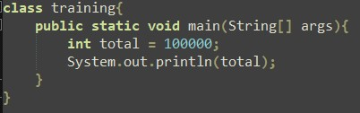
Int Example
Code:
Output:

Slide 10
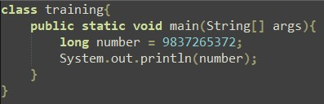
Long Example 1
Code:
Output:

Slide 11
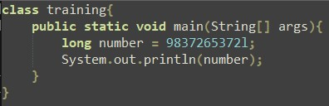
Long Example 2
Code:
Output:

Slide 12
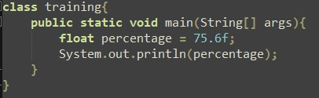
Float Example 1
Code:
Output:

Slide 13
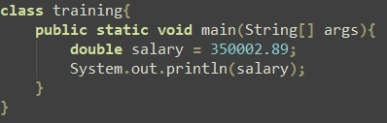
Double Example
Code:
Output:

Slide 14
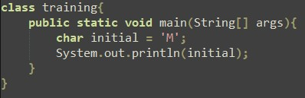
Char Example
Code:
Output:

Slide 15
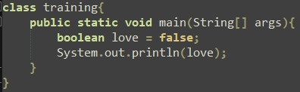
Boolean Example
Code:
Output:

Slide 16
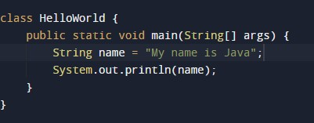

String Example
Code:
Output:

Slide 17
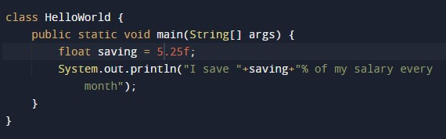

Example
Code:
Output:

Slide 18
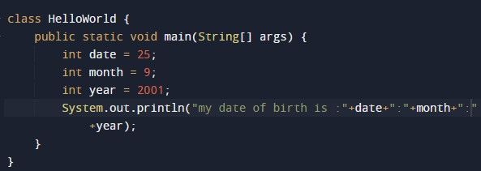

Example
Code:
Output:

Slide 19
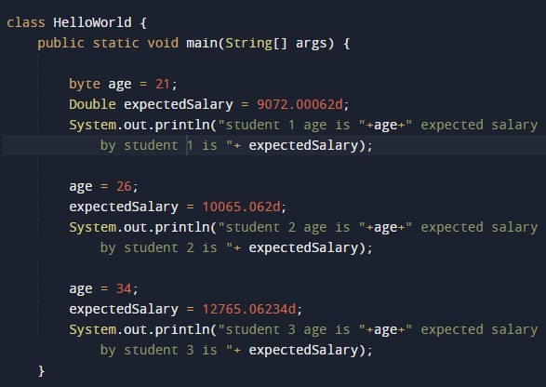

Example
Code:
Output:

Slide 20
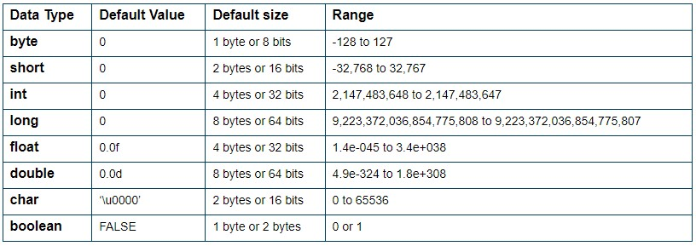
Datatypes

Slide 21
Thank You

